Slide 1
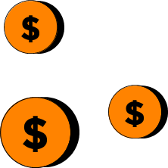

Financial Literacy App SOEN 6841 Software Project Management
GitHub Link: https://github.com/sannidhi470/SPM-Project
Presentation by -
Group 4 Sannidhi Shetty 40276709
Priyanshu Adhikari 40262789
Himanshu Rathod 40234325
Simran Simran 40269778

Slide 2

Introduction & Problem Statement
Why?
In today's complex economy, financial literacy is essential.
However, bridging financial institutions with widely used financial apps remains a challenge.
Existing apps often lack real-time data, limiting their ability to offer personalized guidance.
Our presentation explores these challenges and presents a comprehensive software solution.
Bridging Financial Institutions and Apps
We want to transform financial literacy by connecting banks and popular financial apps.
Right now, users struggle to get real-time transaction data, which makes smart money decisions tough.
Our project aims to seamlessly integrate financial institutions with our software solution, providing users with personalized insights and educational tools.
"Money talks... mine says goodbye too quickly!"

Slide 3

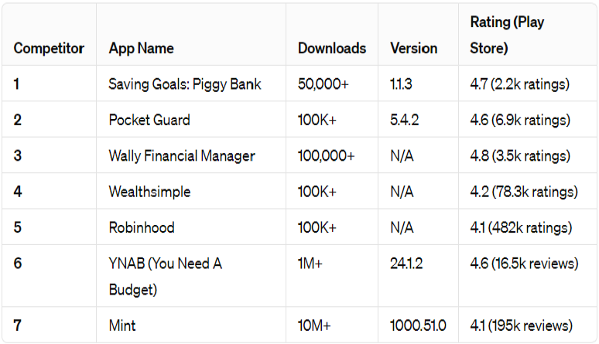
Competitor and Stakeholder Analysis
Market Trends:
AI in Finance: Personalized advice and fraud detection.
Blockchain: Faster, more secure, and transparent transactions.
Mobile Payments: Convenient, secure, and integrated with banking services.
Regulation: Constantly evolving to ensure transparency and protect consumers.
Competitors’ Metrics:
Stakeholder Analysis:
Users: Primary beneficiaries interested in a seamless financial management and educational experience.
Financial Institutions: Provide essential data and prioritize data security and regulatory compliance.
App Developers/Project Team: Responsible for development, aiming for a user-friendly, secure, and effective application.
Regulatory Bodies and Compliance Authorities: Oversee data security, privacy, and compliance; ensure legal adherence.
Financial Experts and Educators: Contribute educational content and promote financial literacy.
Investors or Funding Organizations: Provide financial support and expect a return on investment.

Slide 4
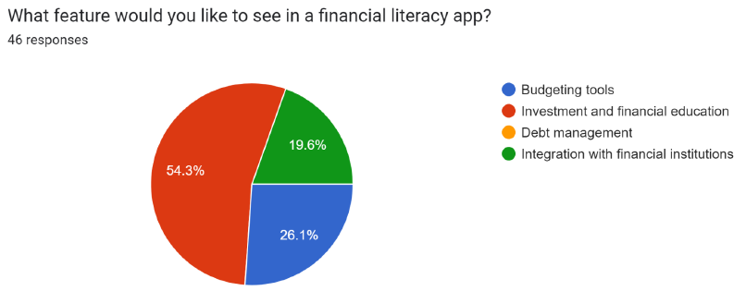

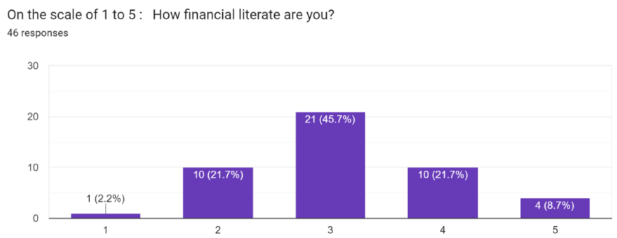
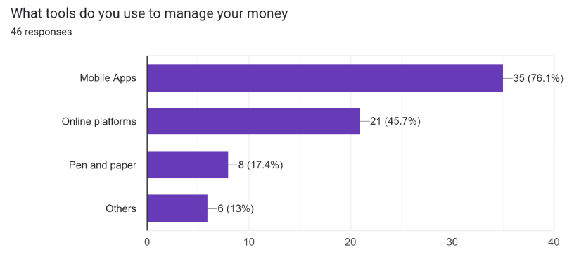
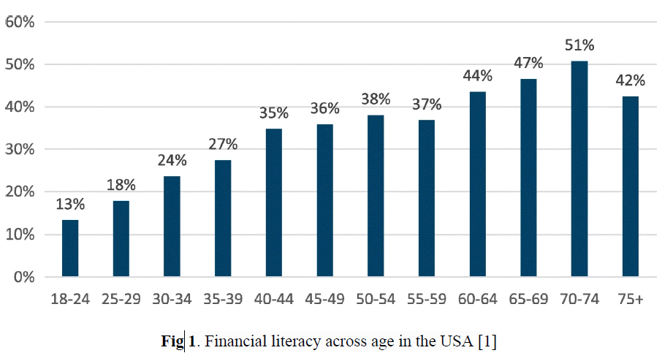
Target Audience
Demographics: Income-earning individuals aged 18-60.
Financial Knowledge: Tailored content for varying levels, from novice to advanced.
Key Age Groups:
Young Adults (18-30): Need foundational financial education.
Parents and Families (25-45): Seek user-friendly platforms with time-efficient features.
Millennials (22-40): Diverse financial goals across different life stages.
Gen X (35-55): Focus on retirement planning and income security.
Seniors/Retirees (55+): Emphasis on retirement income and financial management.
User Survey Insights:
Conducted via Google survey. (Survey link)
Highlighted user interest in investment and shaped project focus.

Slide 5

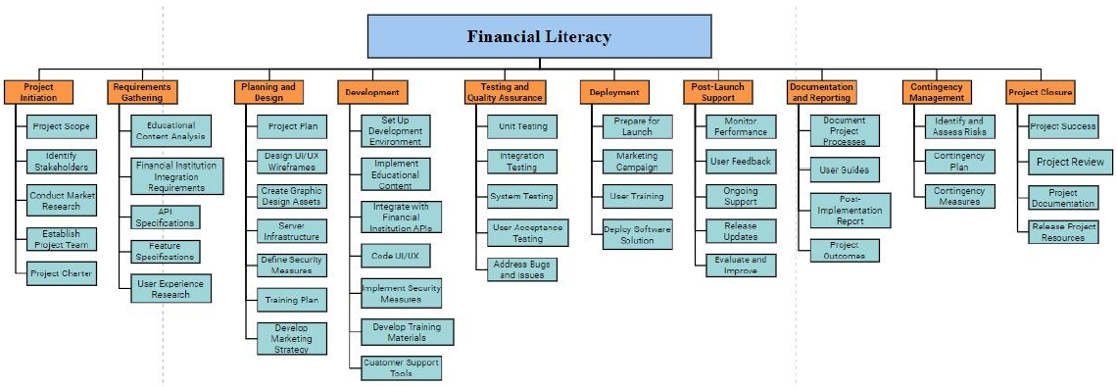
Project Plan
Work Breakdown Structure (WBS) for Project Planning

Slide 6

Solution Proposal - Key Features
Seamless Integration with Financial Institutions: API Integration, OAuth 2.0, Data Encryption, Error Handling.
Real-Time Transaction Analysis: Data Streaming, Machine Learning Algorithms, Data Visualization, Event-Driven Architecture.
Individualized Budgeting Guidance: Data Analysis, Budgeting Algorithms, Financial Optimization, Personalized Recommendations.
Customized Financial Goal Monitoring: Database Management, Progress Tracking, Actionable Steps, Notifications.
Interactive Learning Tools: Content Management System, Interactive Components, Gamification, Analytics.
Financial Coaching Services: Appointment Scheduling, User Profile Management, Communication Tools, Financial Planning Software.
BENEFITS:
Empowers users with real-time insights and personalized guidance.
Enhances financial literacy through interactive learning tools.
Facilitates goal achievement with customized financial monitoring and coaching services.

Slide 7
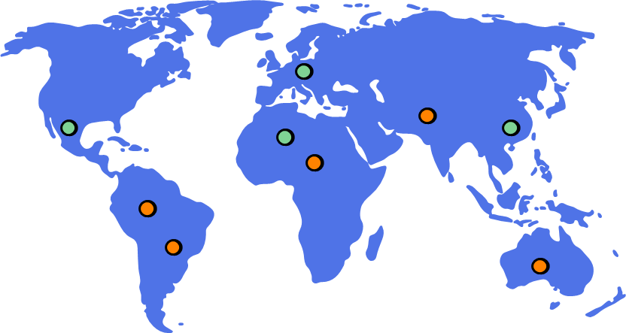
Impact and Alignment with Industry
Limited Access to Personalised Financial Education: Personalised Educational modules enhance financial literacy effectively.
Inefficient Budgeting and Expense Tracking: Real-time analysis helps budgeting efficiently.
Lack of Integration with Financial Institutions: Integration provides comprehensive financial data access.
Low user Engagement with Traditional Financial Apps: Hassle free addition of numbers and community features boost user engagement.
Inadequate Real-Time Financial Insights: Real-time insights enable proactive financial decisions.
Data Security and Privacy Concerns: Robust security measures address data privacy effectively.

Slide 8
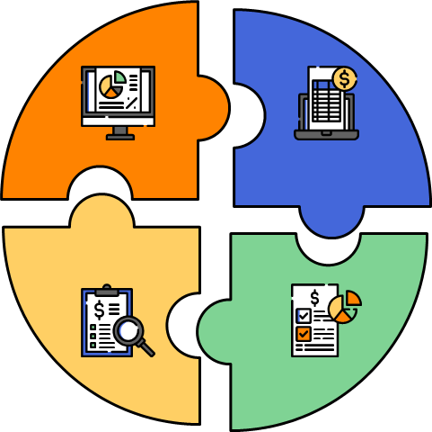
Cost and Effort Estimation
Let’s talk numbers!
The numbers are as follows -:
Project Scope and Requirements Analysis: $10,000
Development Costs: $70,000
Technology Infrastructure:$33,000
Design and User Experience:$20,000
Quality Assurance and Testing:$20,000
Marketing and Promotion:$25,000
Training and Support:$25,000
Legal and Compliance:$12,000
10% buffer : $24,000
Maintenance:$20,000
Estimated Cost : $200K

Slide 9
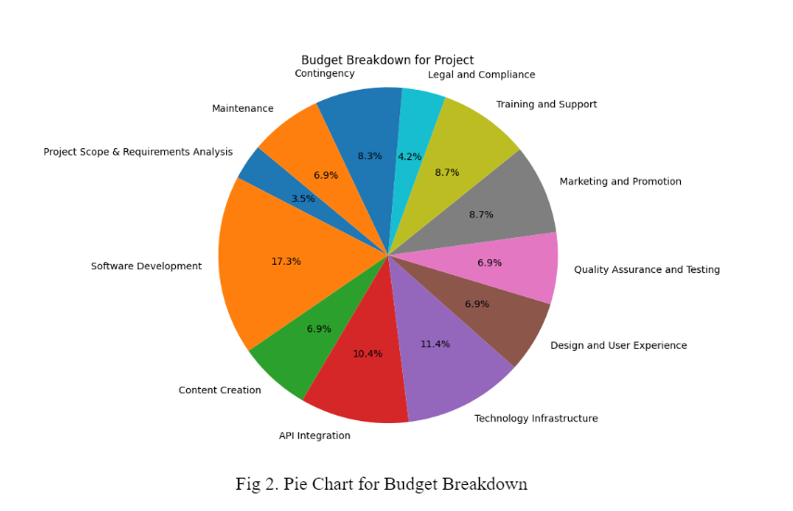

Slide 10

Risk Assessment & Mitigation
Approach: Identify, Analyze, Mitigate
Key Risks: Technical, Resource, Timeline, Financial, Market
Mitigation: Tailored Strategies such as robust encryption for data security vulnerabilities and conducting skills assessments

Slide 11

Conclusion
The Financial Literacy App stands as a beacon of financial empowerment. Its impact resonates beyond numbers, fostering confidence and independence in users. With gratitude, we embark on a journey of continuous improvement, dedicated to shaping brighter financial futures.

Slide 12

THANK YOU for your time !
Any Questions?!

